Slide 1
Discrete-time noise filtering for Pulse-Processing in particle physics experiments
Diego Ávila
This work was supported by the National Commission for Scientific and Technological Research (CONICYT) of Chile under grant FONDECYT 11110165 and scholarship CONICYT-PCHA/Magíster Nacional/2013 - folio 221320673.

Slide 2
Outline
Motivations
Basic concepts: noise analysis for pulse-processing in particle physics experiments
Noise analysis in pulse-processing discrete-time filters
A SC filter for arbitrary weighting function synthesis
Results
Conclusion

Slide 3
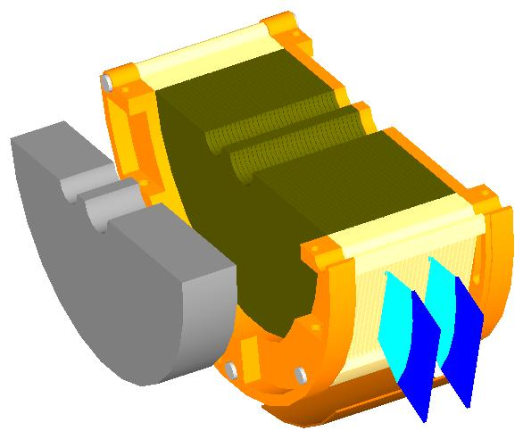
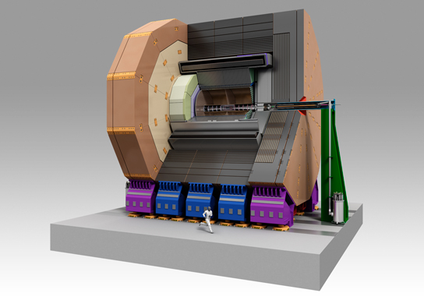
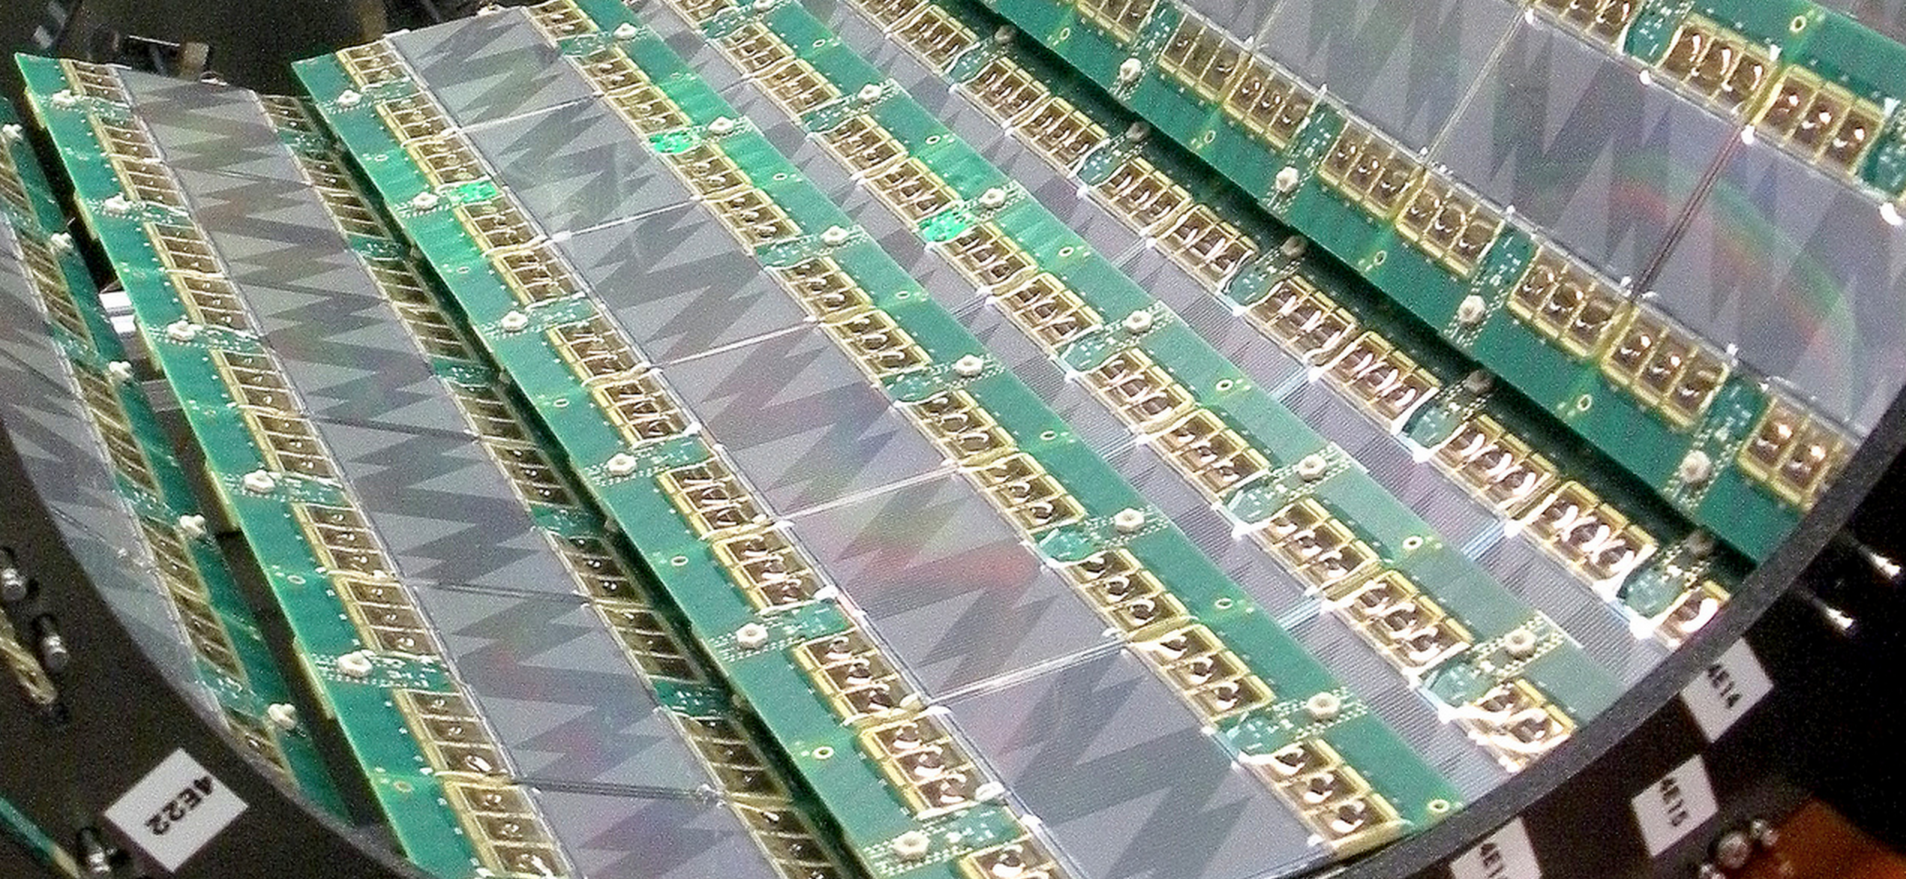
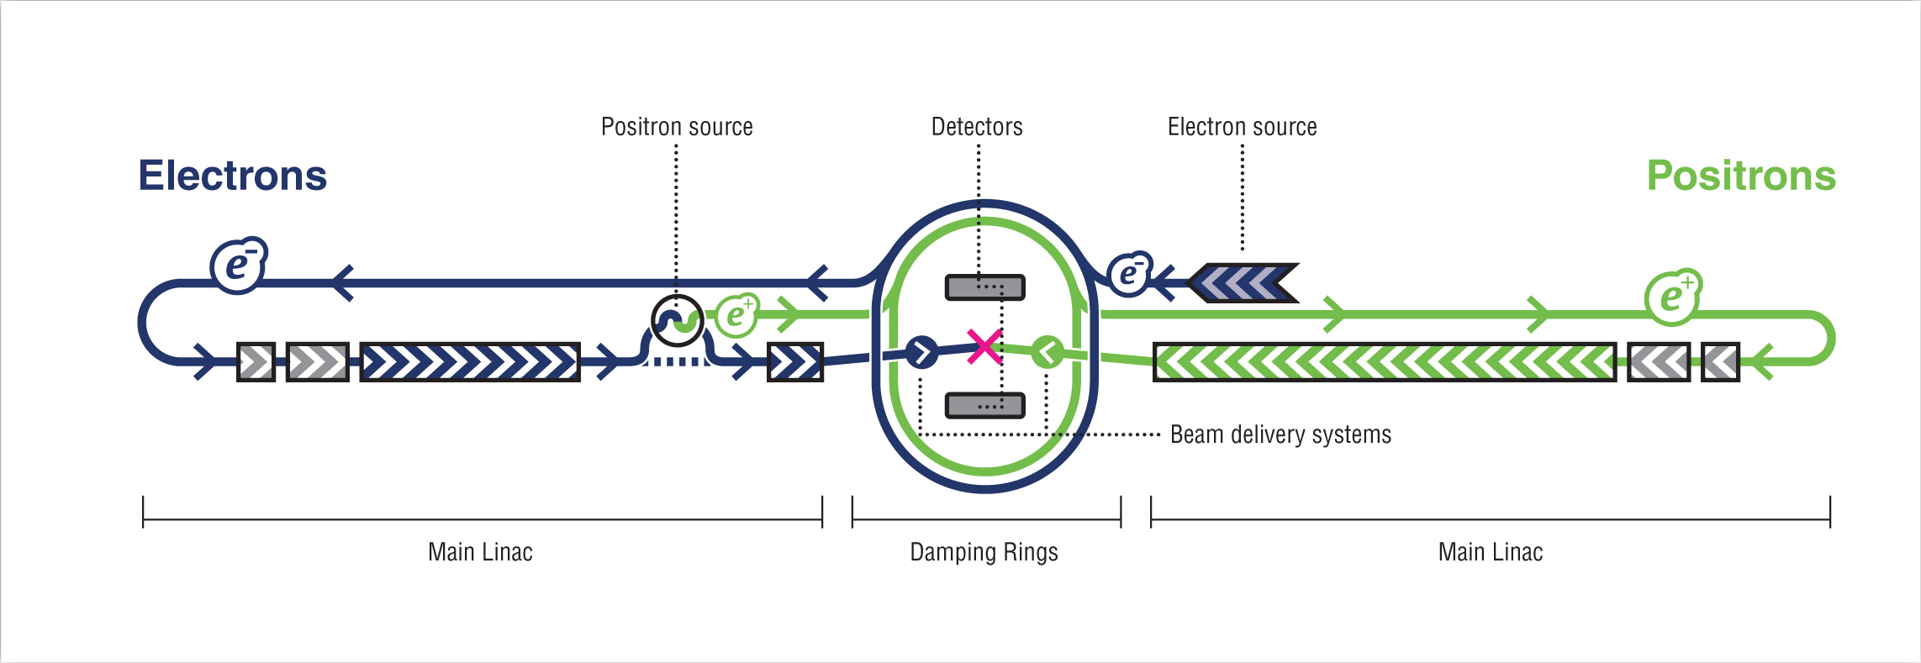
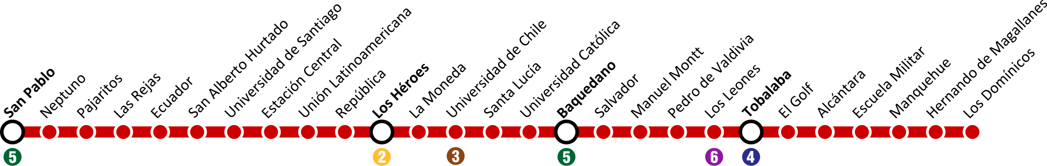
Motivations: the ILC

Slide 4
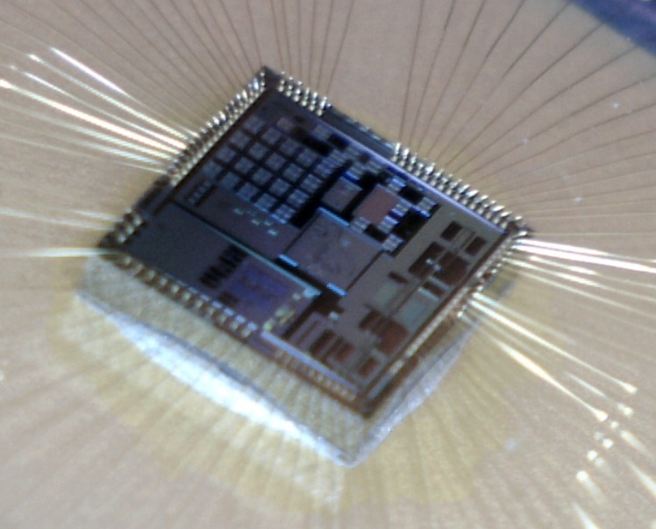
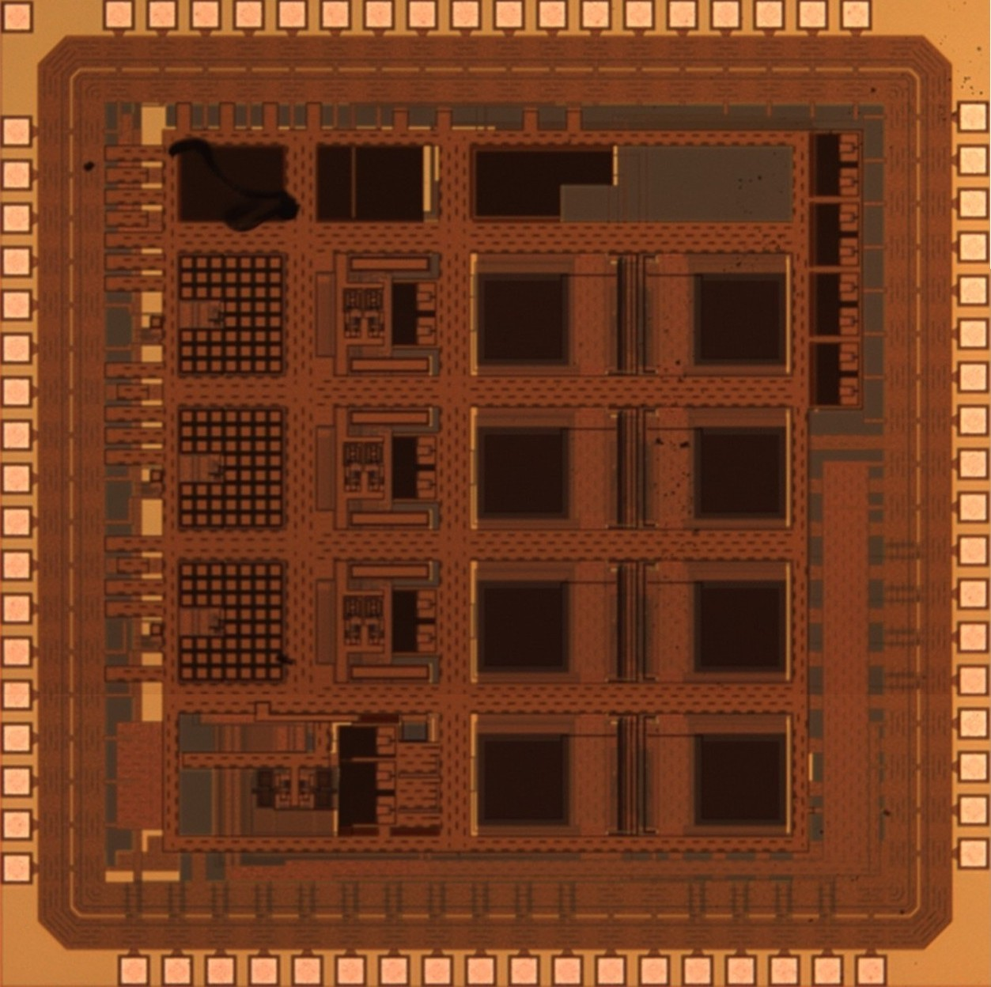
Motivations: the Bean

Slide 5
Basic concepts: noise analysis for pulse-processing in particle physics experiments
Electronic noise.
Most of the times we deal with continuous processes: we assume that the noise process started at - ∞.
Thus, we are used to model the noise in the frequency domain.

Slide 6
… but in pulse-processing for particle physics
Start after restarting C_{F}
End after taking the sample
Finite-time process
A continuous-time noise analysis is more intuitive

Slide 7
Weighting function
White noise can be modeled as a Poisson sequence of Dirac impulses.
system
Ts

Slide 8
Problem
What if?
system
= Discrete-time system
EX. GIGANTE

Slide 9
Our approach: Discrete-time noise analysis

Slide 10
Discrete-time noise analysis

Slide 11
Discrete-time noise analysis

Slide 12
Discrete-time noise analysis

Slide 13
Discrete-time noise analysis

Slide 14
SNR maximization
In the following configuration
Where

Slide 15
SNR maximization
we want to minimize
Independent variables

Slide 16
SNR maximization: results

Slide 17
SNR maximization: results

Slide 18
SNR maximization: results

Slide 19
A SC filter for arbitrary weighting function synthesis
UMC180nm (through Europractice)
Mentor graphics tools (ICUC new analog toolchain)

Slide 20
Specifications
Operation speed: 51.95 MHz
Dynamic range: 10 bits
Input/output swing: ~ 1 V
Gain resolution: 6 bits

Slide 21
Design process
Simple equations
gm/Id methodology
Semi-exhaustive script
Iteration

Slide 22
Architecture

Slide 23
Bias

Slide 24
β-multiplier

Slide 25
Results

Slide 26
Results

Slide 27
Results

Slide 28
Results

Slide 29
Results

Slide 30
Results

Slide 31
Functionality: WF synthesis

Slide 32
Functionality: WF synthesis

Slide 33
Functionality: variable gain
Due to the binary cap arrangement
Filter step response (64 available gains)

Slide 34
Functionality: control signals

Slide 35
Linearity

Slide 36
Conclusion
Development of a new mathematical framework for a design-oriented analysis of discrete-time filters in the discrete-time domain.
Design and implementation of a switched capacitor filter for arbitrary weighting function synthesis.

